Slide 1



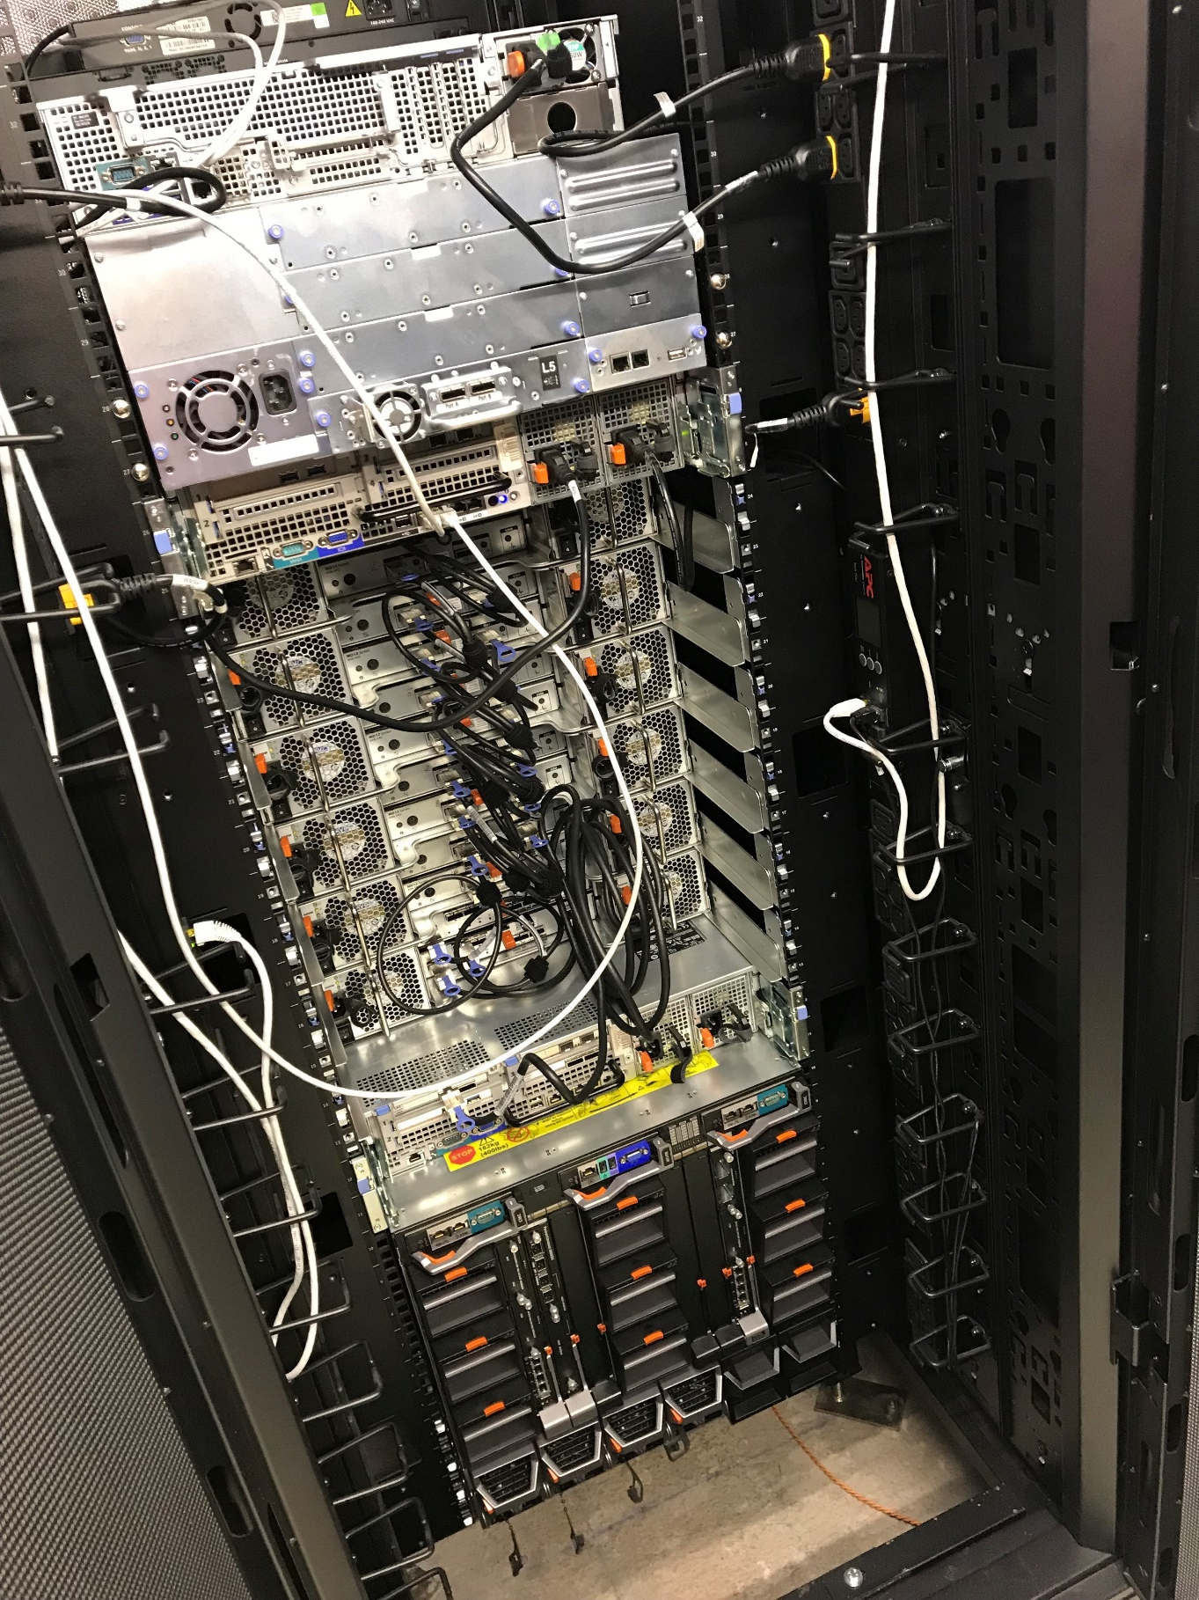




Teaching with JupyterHub - lessons learned
Prof. Martin Christen FHNW – University of Applied Sciences and Arts Northwestern Switzerland School of Architecture, Civil Engineering and Geomatics Institute Geomatics
martin.christen@fhnw.ch
MartinChristen GitHub: MartinChristen
GitLab: martin.christen
Notes:
Teaching with JupyterHub - lessons learned
JupyterHub allows creating a multi-user Hub which spawns multiple instances of the Jupyter notebook server. At the Institute Geomatics of the University of Applied Sciences and Arts Northwestern Switzerland JupyterHub is used for teaching Python in the master's course "GeoProcessing". The course uses large-scale (multi-terabyte) geodata and local instances of the Jupyter Notebook are no option. This talk shares experiences in setting up JupyterHub and it is shown how notebooks and exercises are shared with the class. The Institute of Geomatics also uses JupyterHub for research projects, especially involving deep learning or other tasks where GPUs and a high performance compute clusters are required. It will be shown how we currently set this up and how we plan to do it in near future.

Slide 2
https://github.com/martinchristen/EuroSciPy-2018-JupyterHub

Slide 3
What am I teaching ? (Python related courses only)
Bachelor Programme Introduction to Python (1st Semester) Programming I (2nd Semester) Programming II (3rd Semester) Open (Geo-)Data Seminar (5th Semester)
Masters Programme Geoprocessing (14 Lessons)

Slide 4
Where? Our New Campus (4500 People, 250M €, built in 4 years)

Slide 5
What am I teaching ? (Python related courses only)
Bachelor Programme Introduction to Python (1st Semester) Programming I (2nd Semester) Programming II (3rd Semester) Open (Geo-)Data Seminar (5th Semester)
Masters Programme Geoprocessing (14 Lessons)
This course is about processing big geo data
Aerial images/Satellite images are large! (Petabyte range)
Problem #1 How can students store multiple 2-4 TB datasets?
Problem #2
Installing all required modules takes forever

Slide 6

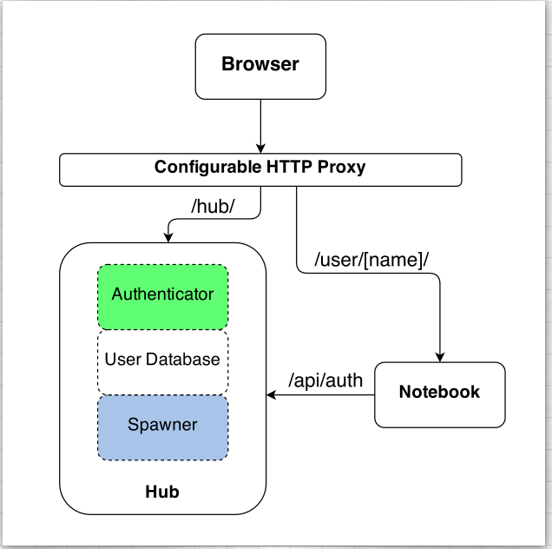
About JupyterHub
Jupyterhub: Jupyter for multiple users
The Hub launches a proxy
The proxy forwards all requests to the Hub by default
The Hub handles user login and spawns single-user servers on demand
The Hub configures the proxy to forward URL prefixes to the single-user notebook servers
Image from https://jupyterhub.readthedocs.io

Slide 7
Installation
Installation is easy if you read the docs:
https://jupyterhub.readthedocs.io/en/stable/installation-guide.html
You need Linux
You can use Docker
You can install Jupyterhub without Docker
Cluster? GPU?
https://zero-to-jupyterhub-with-kubernetes.readthedocs.io/en/latest/index.html
https://github.com/gifford-lab/jupyterhub
https://ritazh.com/running-jupyter-notebook-and-tensorboard-on-gpu-on-azure-using-kubernetes-e4c43948e9a8
http://mathalope.co.uk/2017/09/25/how-to-setup-tensorflow-jupyter-notebook-on-intel-nervana-ai-cluster-colfax-for-deep-learning/
…and much more…

Slide 8
Configuration
/opt/anaconda3/bin/jupyterhub_config.py
# Custom Logo c.JupyterHub.logo_file = "/path/to/logo.png"
# for Jupyter Lab c.Spawner.cmd = ["jupyter-labhub"] c.Spawner.default_url = '/lab‘ c.Spawner.environment = {'JUPYTER_ENABLE_LAB': 'yes' }

Slide 9
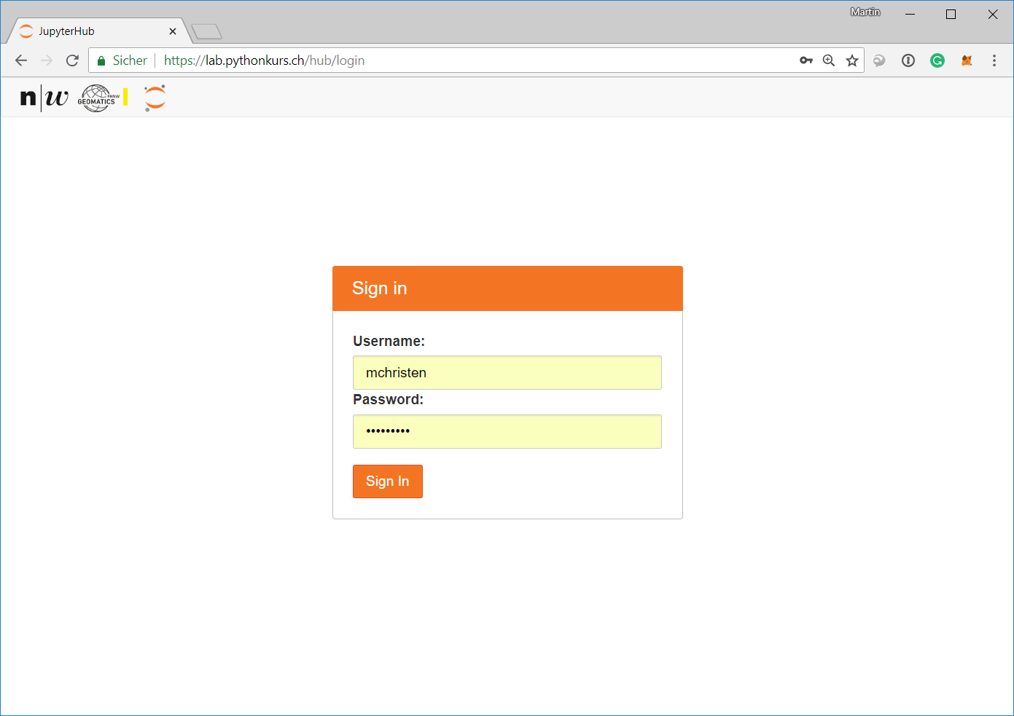
Login to JupyterHub

Slide 10
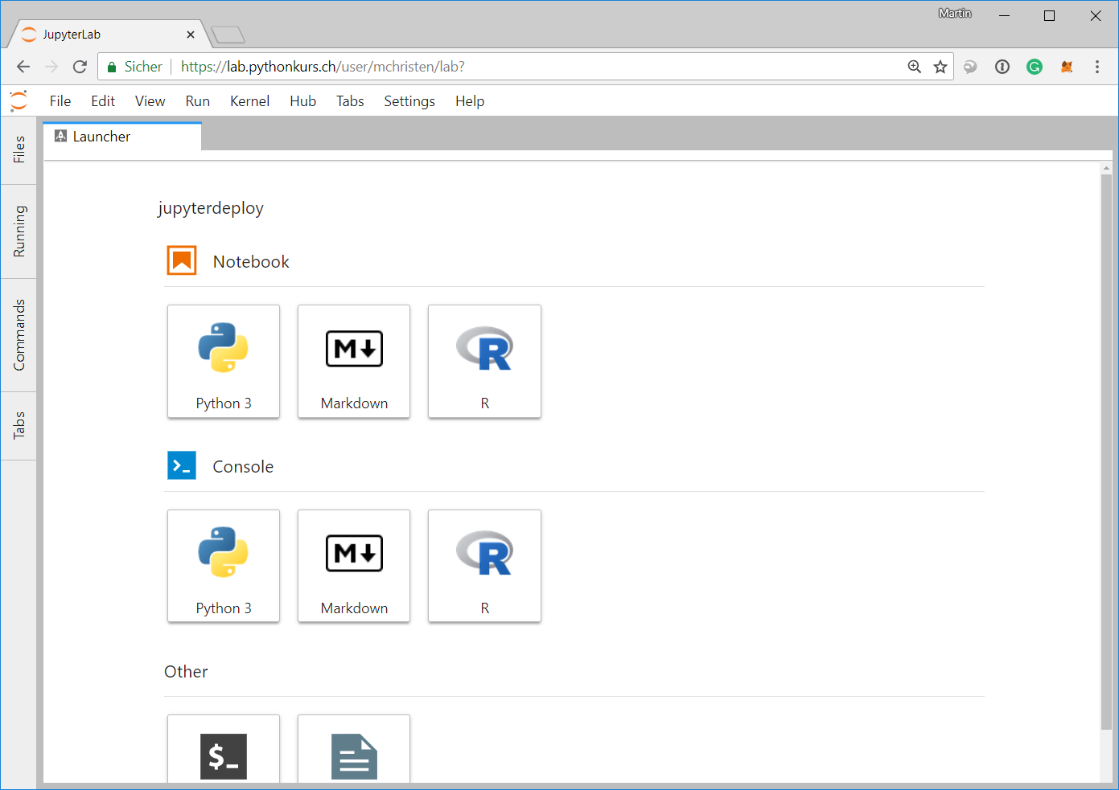
Starting Jupyter Lab for the user

Slide 11
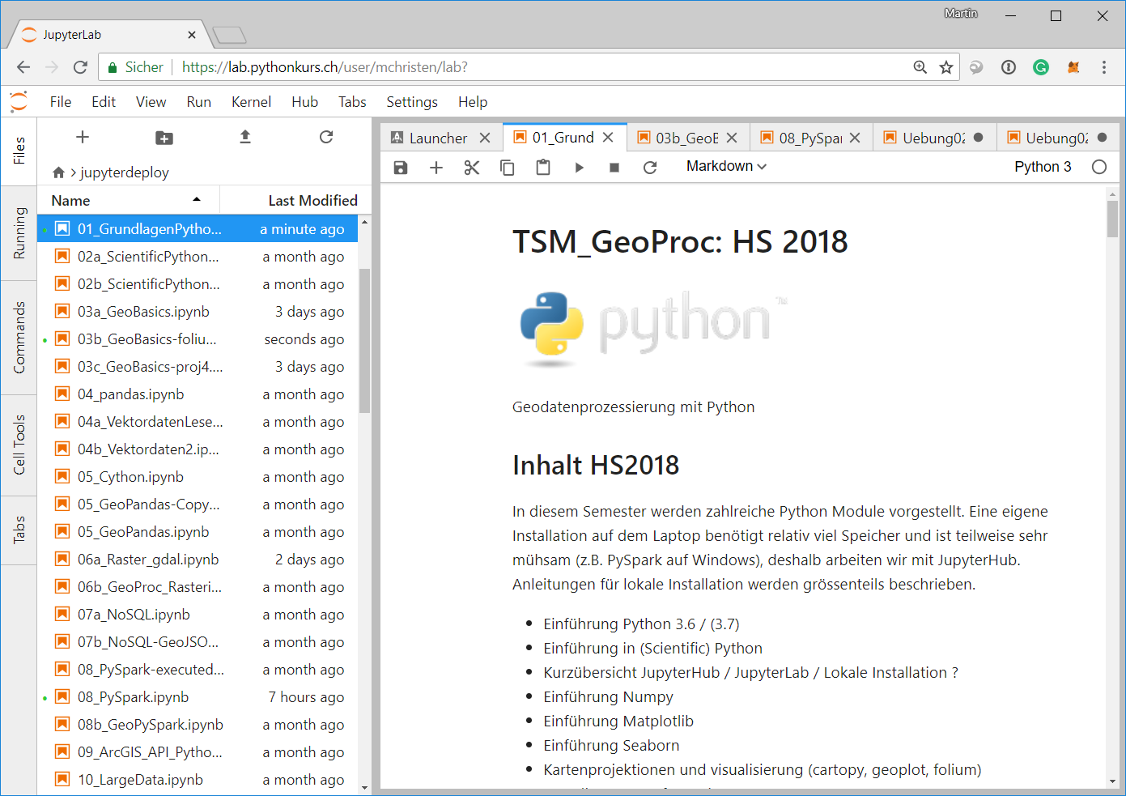
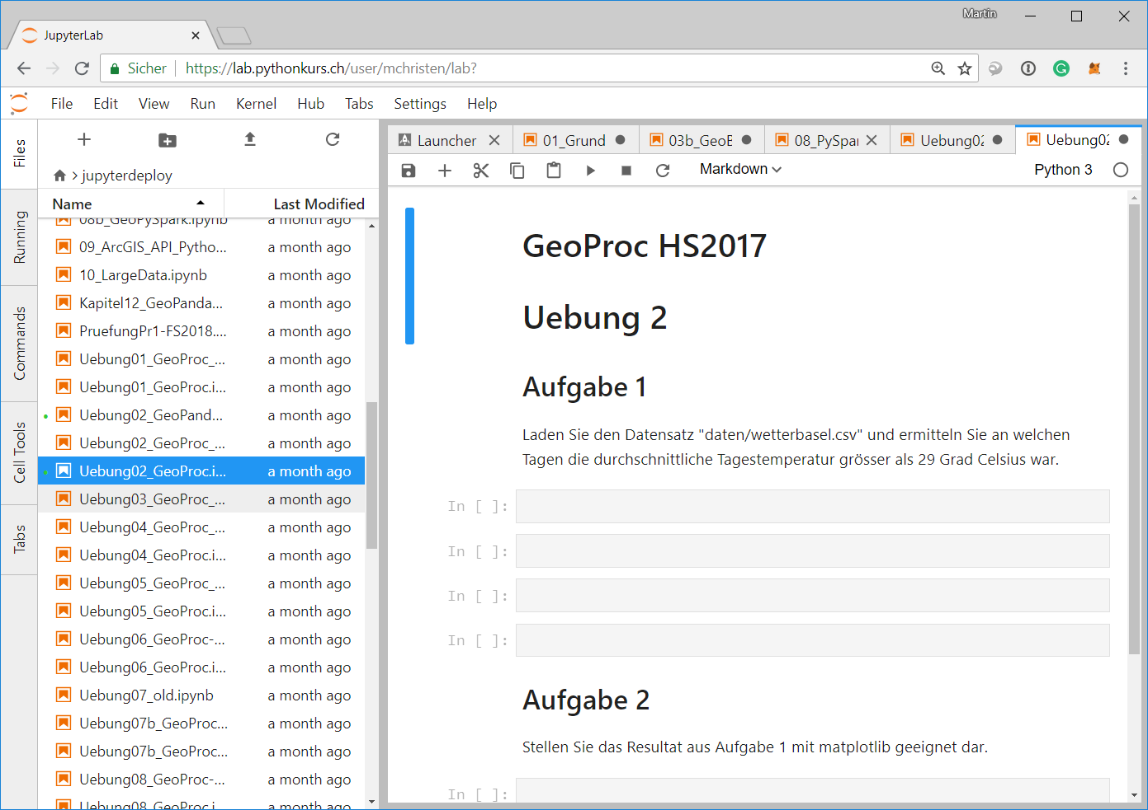
Login to JupyterHub

Slide 12
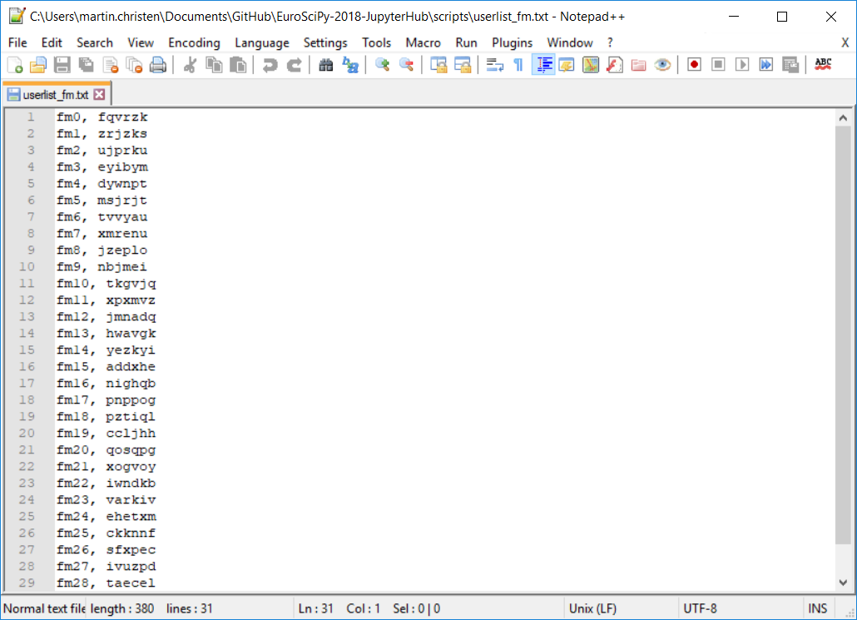
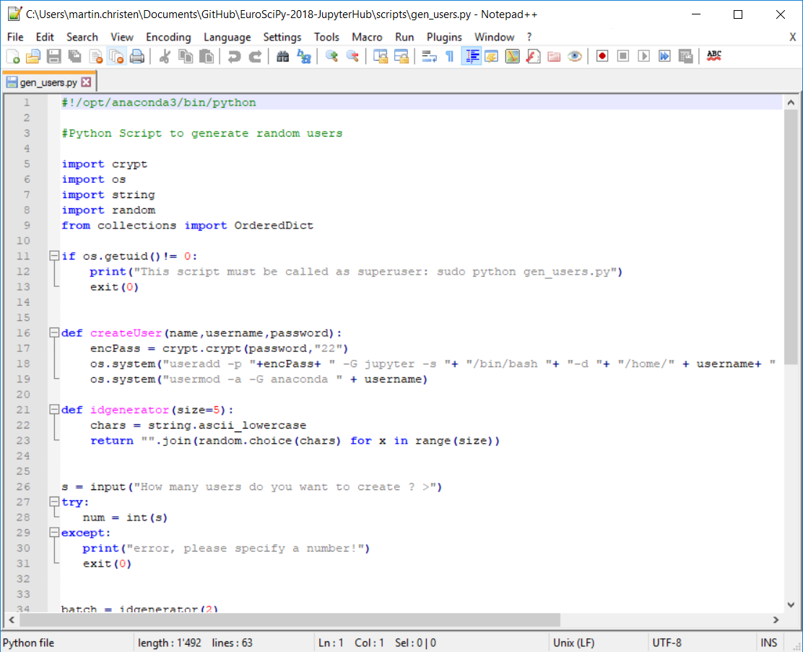
genusers.py - creating User/password for a specific course
Create Users and passwords

Slide 13
deploy_coursename.py
During the course:
Every week there is a new (or serveral new) Jupyter Notebooks available and an Exercise Notebook.
The notebooks are deployed to all students 72h before the next lesson
Also included is a general solution for the exercise
I created a simple deploy script which copies new files to all course members (using the course id created in genusers.py).
Also directories with all contents can be copied (for small datasets, pdf, …)

Slide 14
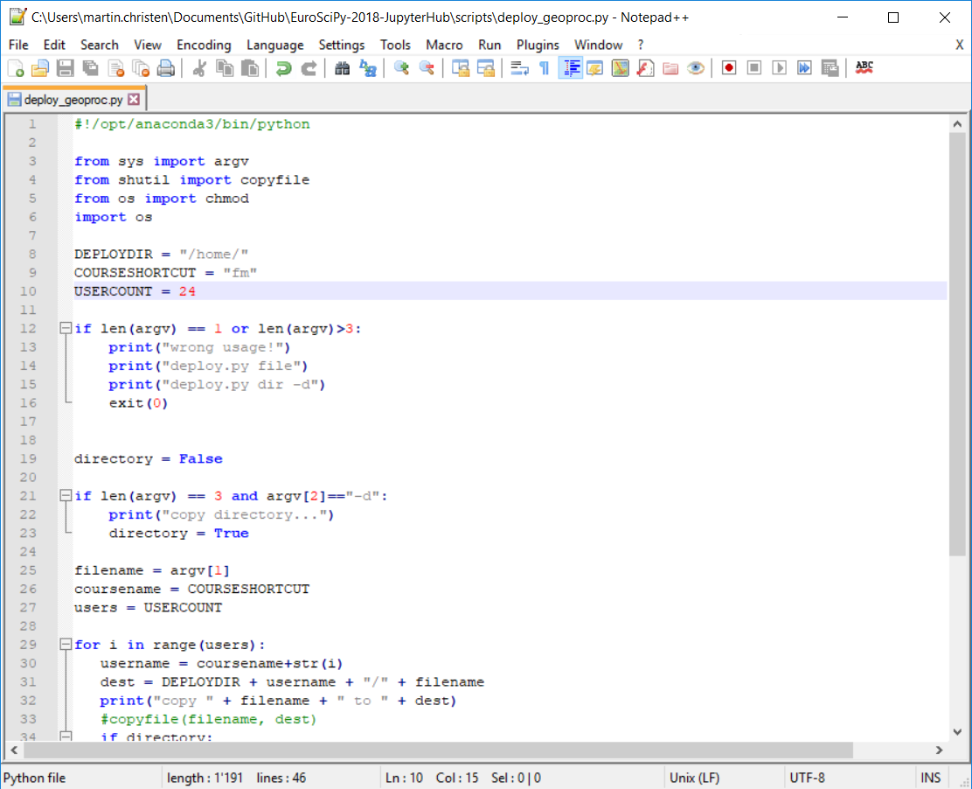
deploy_coursename.py

Slide 15
Large Data Files
Data is just located globally at /data/ and all users have read access.
This way multi TB datasets can be read by all without problems
Example: /data/landsat.tif
Previously I tried to use symbolic links but it didn’t really work (problems with Jupyter and with certain modules)

Slide 16
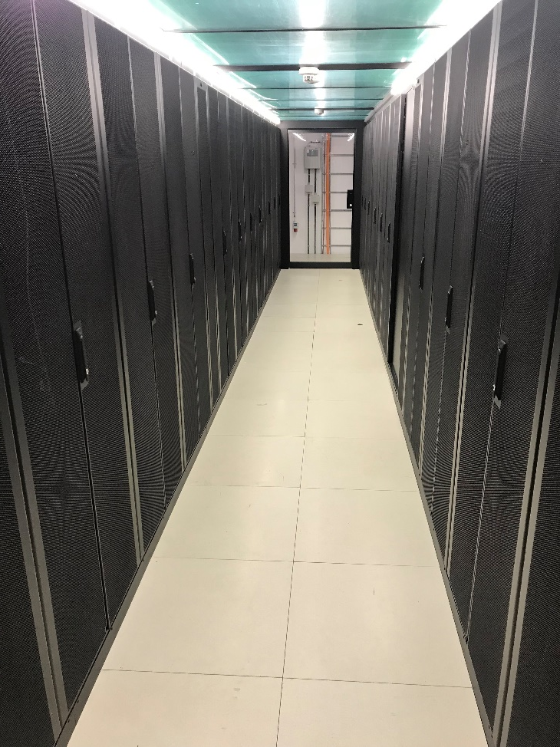
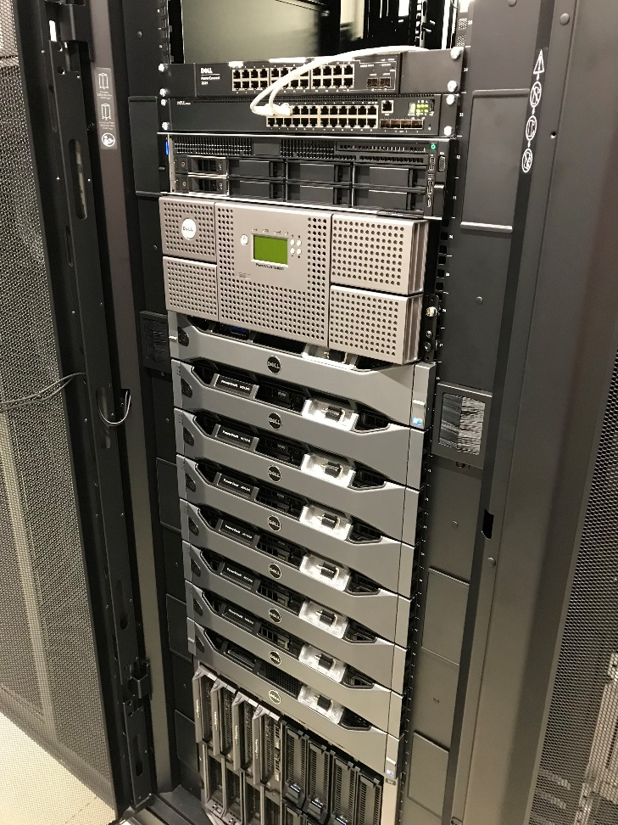

Cluster for JupyterHub
JuypterHub
124 CPU Cores 112 GB RAM 120 TB HD (~1 GB/s read/write)
currently only 4 GPUs, to be increased soon

Slide 17
Conclusion
JupyterHub solves my major problems:
Doing exercises with really large datasets (1-10 TB)
No installation of modules / No time wasted in first lesson
Students don’t need space on their laptop for anaconda/modules/data (if they don’t want to install it locally)
I don’t have to write installation instructions for each OS / Python Version
GPUs can be used even if students don’t have a high-end graphics card.

Slide 18


http://2019.geopython.net
Python in General
GIS/Mapping
Geography / Geophysics / Geodesy / Geomatics
Earth Sciences / Environmental Sciences
Geovisualization
Smart Cities
Spatial Data / Geodata
Geospatial Webservices
Big Data
Data Processing
(Spatial) Databases
Computer Vision
Remote Sensing
Image Processing
(Geo-)Machine Learning / (Geo-)Deep Learning

Slide 19
Questions
?

